Slide 1
What is Software Engineering?

Slide 2
What is Software Engineering?
Software Engineering is the process of designing, developing, testing, and maintaining software.
It is a systematic and disciplined approach to software development that aims to create high-quality, reliable, and maintainable software.
It includes a variety of techniques, tools, and methodologies, including requirements analysis, design, testing, and maintenance.

Slide 3
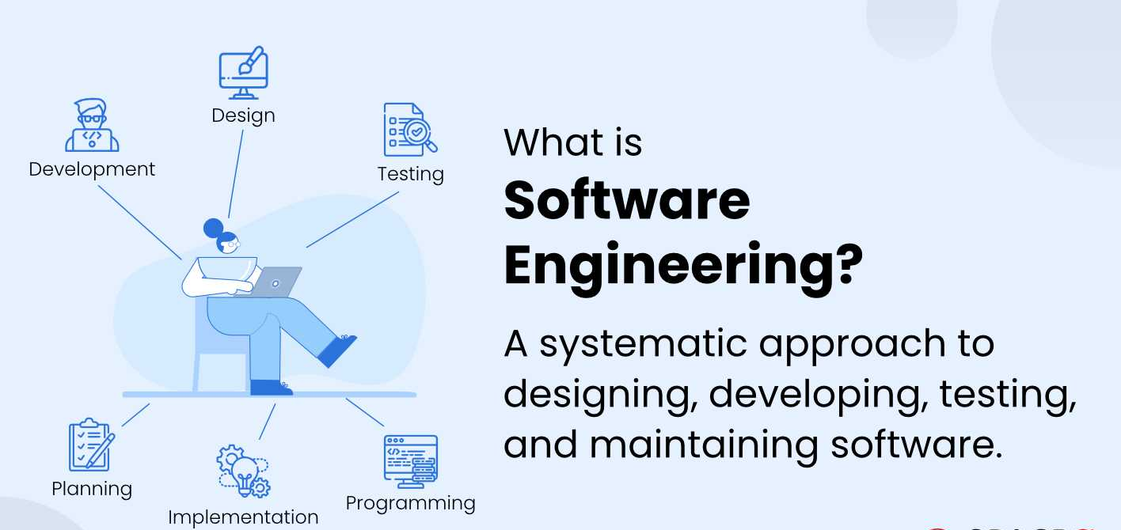
What is Software Engineering?

Slide 4
What is SDLC?
Software Development Life Cycle (SDLC) is a structured process that is used to design, develop, and test high-quality software. SDLC, or software development life cycle, is a methodology that defines the entire procedure of software development step-by-step. The goal of the SDLC life cycle model is to deliver high-quality, maintainable software that meets the user's requirements.
Common phases of SDLC :
Requirements
Design
Implementation
Testing
Deployment
Maintenance

Slide 5
SDLC (Agile, Waterfall, DevOps)

Slide 6
SDLC Models
SDLC models provide different approaches/methodologies for managing development.
Some popular models are :
Waterfall – Traditional, linear approach
Agile – Iterative, flexible, customer-centric
DevOps – Continuous development + deployment + operations

Slide 7
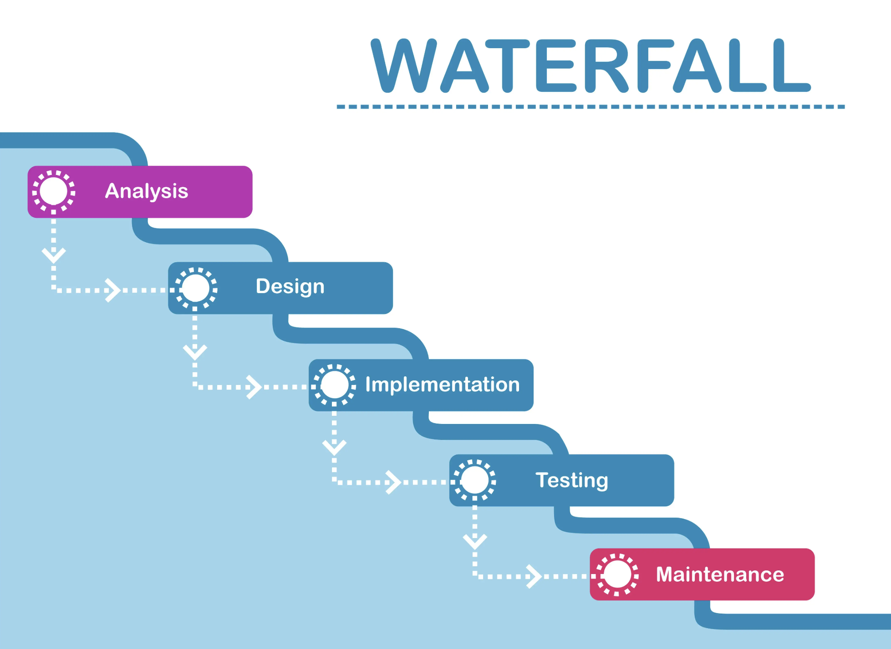
Waterfall Model
Advantages:
Easy to manage
Clear milestones & documentation
Works for small, predictable projects
Disadvantages:
Inflexible, poor at handling change
Testing late, higher risk
User feedback at the end
The Waterfall Model is a Traditional Software Development Methodology. It was first introduced by Winston W. Royce in 1970. It is a linear and sequential approach to software development that consists of several phases.
Oldest and simplest model
Sequential phases, one after another
Works when:
Requirements are clear & stable
Minimal changes expected
Small projects with fixed scope

Slide 8
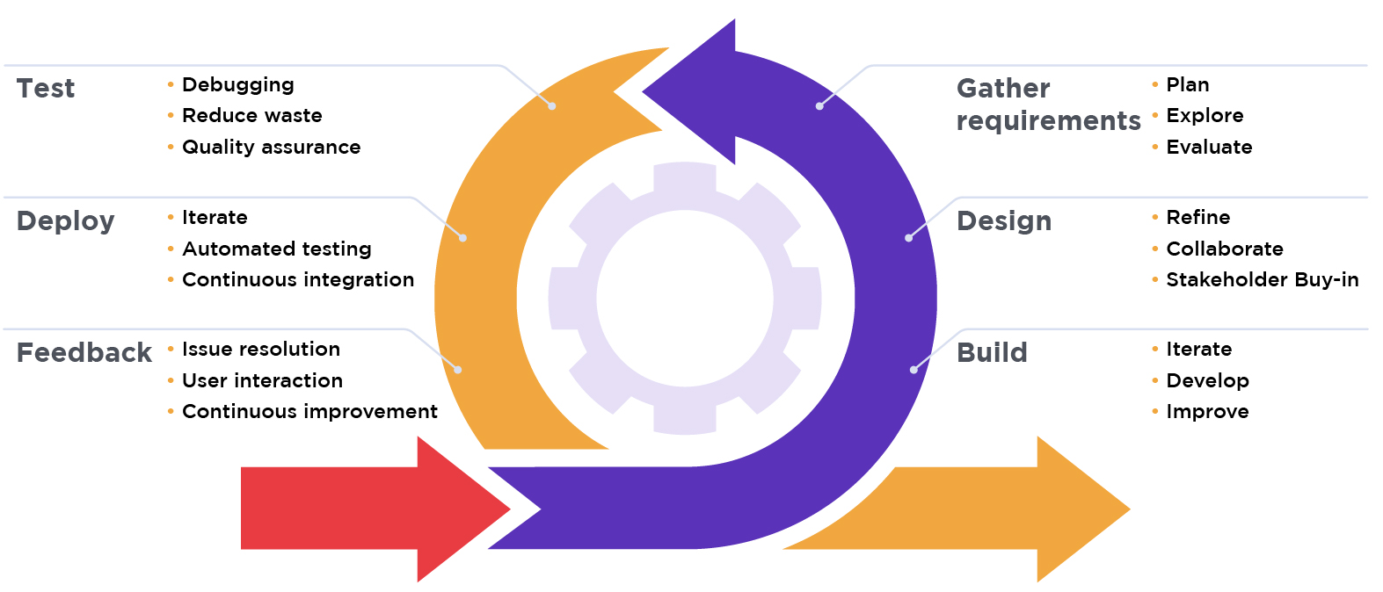
Agile Model
The Agile Model is an iterative and incremental approach to software development. Instead of delivering the whole software at the end, Agile delivers small working parts of software frequently.
Requirements are divided into small features
Each feature is developed in a short cycle (2–4 weeks).
After each cycle, Working software is delivered, Customer feedback is taken, Improvements are made in next cycle
Advantages:
Flexible, adapts to change
Early, continuous delivery
Strong customer collaboration
Reduces risks via small increments
Disadvantages:
Needs skilled teams
Can lead to scope creep
Less focus on formal documentation
Stages of Agile Model

Slide 9
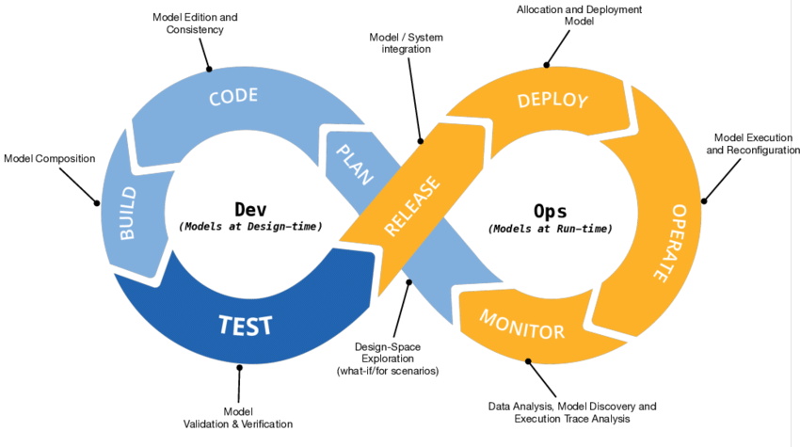
DevOps Model
DevOps combines development (Dev) and operations (Ops).
It focuses on continuous development, testing, integration, deployment, and monitoring with strong collaboration between developers and operations teams.
Stages of DevOps Model
Advantages:
Faster releases
Automated testing & deployment
Improves collaboration
Enhanced monitoring & quick fixes
Disadvantages:
Needs tools & infra investment
Cultural change required
CI/CD complexity

Slide 10
Stages of SDLC

Slide 11
Stages of SDLC
The primary goal of the SDLC process is to produce cost-efficient and high-quality products. The process comprises a detailed plan that describes how to develop, maintain, and replace the software. All are listed below -
Planning
Analysis
Design
Development/Coding
Testing
Deployment
Maintenance

Slide 12
Stage 1: Project Planning
The first stage of SDLC is all about “What do we want
Requirement Analysis
Gather requirements from client/users
Understand what system should do
Stage 2: Gathering Requirements & Analysis
The second step of SDLC is gathering maximum information from the client requirements for the product. Discuss each detail and specification of the product with the customer.
Technical feasibility
Economic feasibility
Operational feasibility
Legal feasibility

Slide 13
Stage 3: Design
In the design phase (3rd step of SDLC), the program developer scrutinizes whether the prepared software suffices all the requirements of the end-user. Additionally, if the project is feasible for the customer technologically, practically, and financially. Once the developer decides on the best design approach, he then selects the program languages like Oracle, Java, etc., that will suit the software.
.

Slide 14
Stage 4: Coding or Implementation
Time to code! It means translating the design to a computer-legible language. In this fourth stage of SDLC, the tasks are divided into modules or units and assigned to various developers.
Developers write code
Use programming languages (Java, Python, etc.)

Slide 15
Stage 5: Testing
Once the developers build the software, then it is deployed in the testing environment. Then the testing team tests the functionality of the entire system. In this fifth phase of SDLC, the testing is done to ensure that the entire application works according to the customer requirements.
After testing, the QA and testing team might find some bugs or defects and communicate the same with the developers. The development team then fixes the bugs and send it to QA for a re-test. This process goes on until the software is stable, bug-free and working according to the business requirements of that system.

Slide 16
Stage 6: Deployment
The sixth phase of SDLC: Once the testing is done, and the product is ready for deployment, it is released for customers to use.
Stage 7: Maintenance
The actual problem starts when the customer actually starts using the developed system and those needs to be solved from time to time. Maintenance is the seventh phase of SDLC where the developed product is taken care of. According to the changing user end environment or technology, the software is updated timely.

Slide 17
Writing Clean & Maintainable Code
Coding standards

Slide 18
What are Coding Standards?
Coding standards are a set of rules, guidelines, and best practices that developers follow to write consistent, clean, and maintainable code. They ensure that code is easy to read, understand, debug, and extend by any team member.
Importance of Coding Standards
Improve readability and understandability of code.
Enable team collaboration by keeping code style consistent.
Reduce bugs and make debugging easier.
Increase maintainability and long-term project health.
Support scalability by ensuring code can grow with fewer issues.

Slide 19
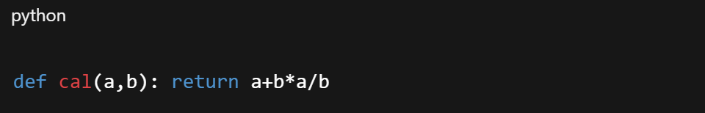
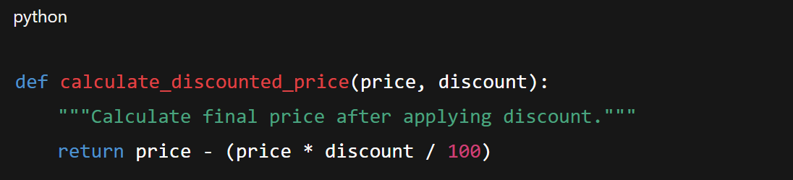
Bad Code vs Good Code
Bad practice:
Good practice:

Slide 20
Using Comments for More Clarity

Slide 21
What are Comments?
Comments are notes written in the code that explain what the code does without affecting its execution. They provide clarity, making it easier for other developers (and your future self) to understand the logic and purpose of the code.
Importance of Comments
Improve readability and help others quickly understand the code.
Serve as documentation for complex logic, functions, or algorithms.
Help in debugging and maintenance by providing context.
Support team collaboration, especially in large projects.
Ensure that code remains understandable long after it was written.

Slide 22
Types of Comments
Inline Comments – Short explanations placed on the same line as code.
Block Comments – Multi-line explanations for sections of code.
Documentation Comments – Used for describing functions, classes, or modules in detail (e.g., docstrings in Python, Javadoc in Java).
Best Practices for Writing Comments
Keep comments clear, concise, and relevant.
Avoid stating the obvious (don’t explain trivial code).
Update comments whenever code changes.
Use comments to explain why, not just what.
Follow team or language-specific commenting style guides.

Slide 23
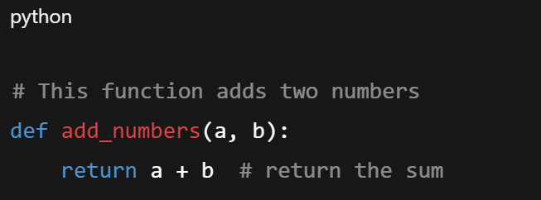
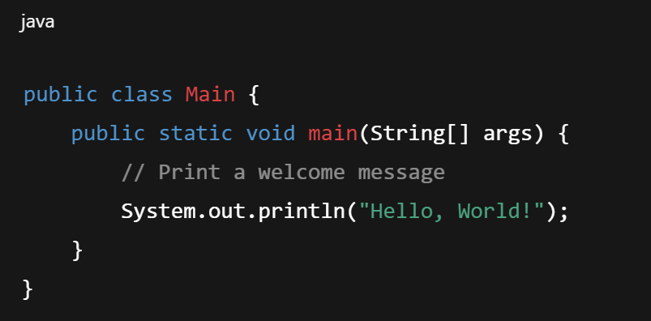
Examples of Comments
Single-line (Inline) Comments

Slide 24
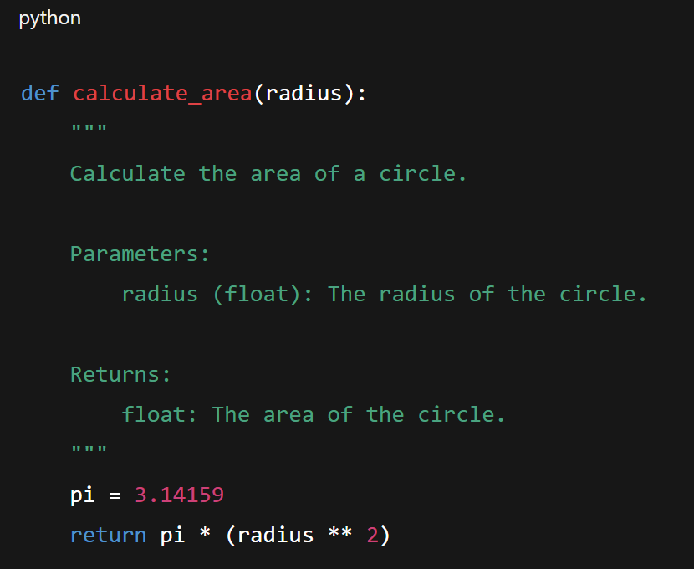
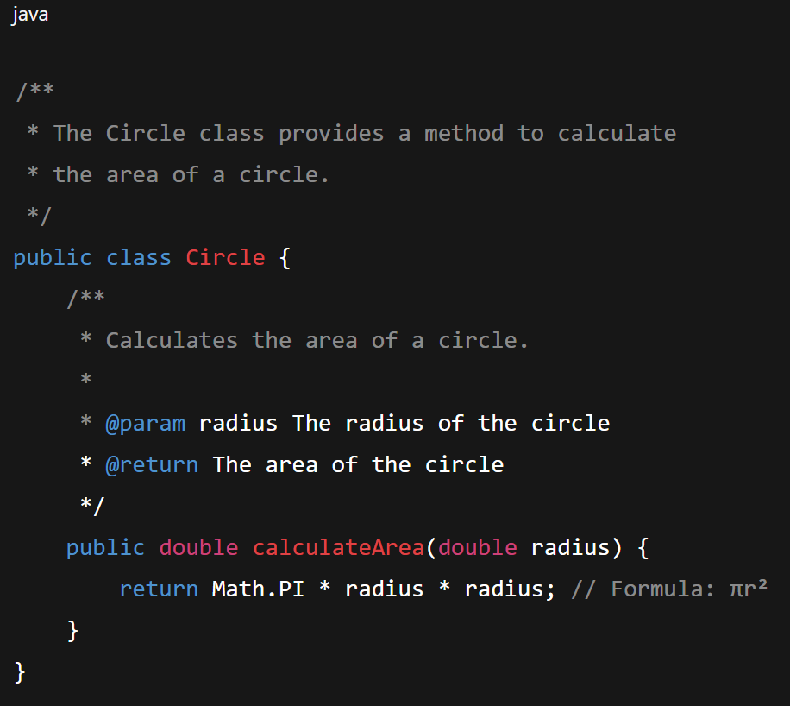
Examples of Comments
Multi-line (Block) Comment

Slide 25
Project folder structure

Slide 26
What is Project folder structure?
A project folder structure defines how files and directories are organized in a software project. A clear structure improves code readability, maintainability, and collaboration. It also ensures that developers can easily find, modify, and manage project files and helps maintain consistency across different projects and teams.
Importance of a Proper Folder Structure
Organization: Groups related files together for clarity.
Scalability: Supports adding new modules or features without confusion.
Collaboration: Team members can navigate and understand the project easily.
Maintainability: Simplifies debugging, testing, and updating code.
Best Practices: Encourages adherence to coding standards and version control.

Slide 27
Common Folder Structure in Software Projects
src/ – Contains source code files.
docs/ – Documentation related to the project.
tests/ – Test scripts and unit tests.
assets/ – Images, CSS, JavaScript, or other static files.
config/ – Configuration files, environment variables, and settings..
build/ or dist/ – Compiled code or production-ready files.
README.md – Project overview and instructions.

